Slide 1
Uninformed search solutions- 8 puzzle problem
Swati Mali
swatimali@somaiya.edu

Slide 2
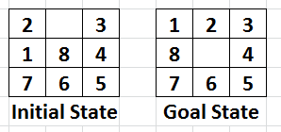
Problem

Slide 3
Goal formulation
Arrange 1-8 numbered tiles as per the sequence given in problem statement

Slide 4
Problem formulation
State description- 3 X 3 grid of tiles numbered through 1 to 8 and a blank tile.
Initial state – given combination of 3 X 3 grid
8-puzzle(2,$,3,1,8,4,7,6,5)
Actions- left(), right(), up(), down()
Successor function (on goal state)
<left(), 8-puzzle(1,2,3,$,8,4,7,6,5)>
<right(), 8-puzzle(1,2,3,8,4,$,7,6,5)>
<up(), 8-puzzle(1,$,3,8,2,4,7,6,5)>
<down(), 8-puzzle(1,2,3,8,6,4,7,$,5)>

Slide 5
Problem formulation
Goal test – explicit; as given in problem statement
Path cost- 1 per step

Slide 6
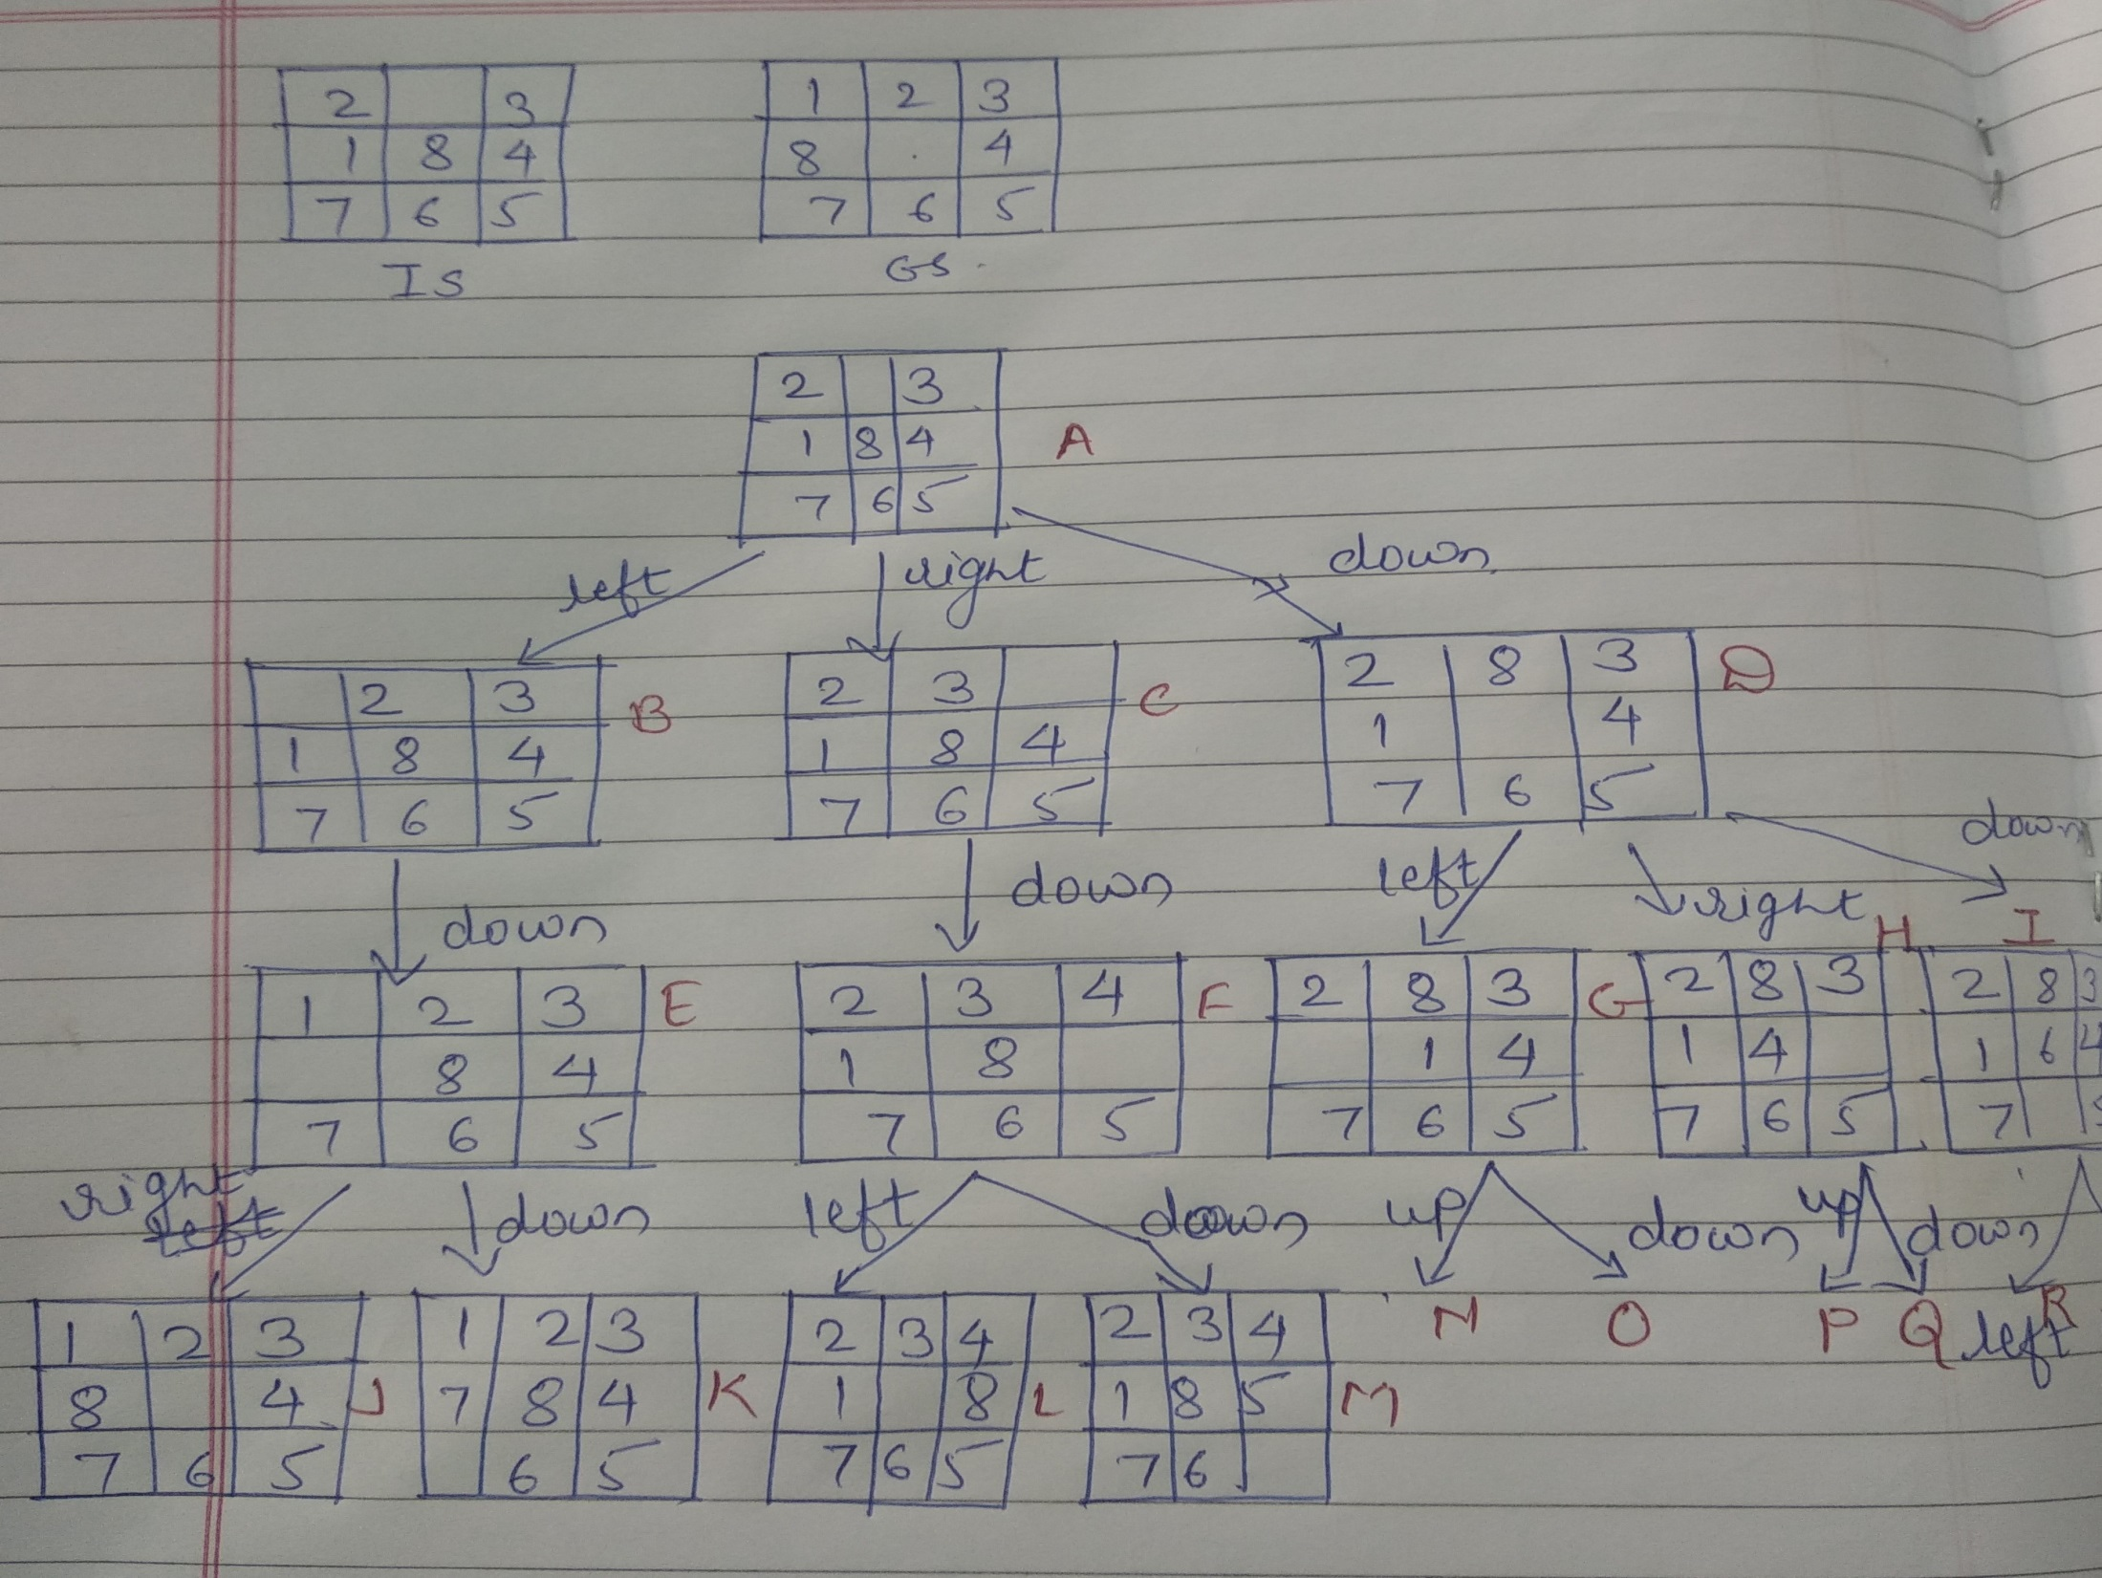
State space tree

Slide 7
BFS, DFS, DLS, IDS
BFS
DFS
DLS
IDS

Slide 8
Costs?

Slide 9
Thank you

